Slide 1

BASIC MANUAL

Slide 2
Contents
1. ADMIN SETTING
A. ADMINISTRATOR . . . . . . . . . 3 ~ 11
2. USER Setting Function
A. USER Setting . . . . . . . . . 12 ~ 15 PAGE
3. SETTING 16 PAGE
A. MAIN . . . . . . . . . 17 ~ 26 PAGE
B. SCREEN . . . . . . . . 27 ~ 28 PAGE
C. PRINT . . . . . . . . . . 29 ~ 30 PAGE
D. PAYMENT . . . . . . . . . 31 ~ 41 PAGE
E. DISCOUNT . . . . . . . . . 42 ~ 45 PAGE
F. TAX TABLE. . . . . . . . . . 46 ~ 47 PAGE
G. PRODUCT. . . . . . . . . . 48 ~ 51 PAGE
H. CUSTOMER. . . . . . . . . . 51 ~ 54 PAGE
I. ALERT. . . . . . . . . . 55 ~ 56 PAGE
4. SALES 방법 58 PAGE
A. REGISTER OPEN / CLOSE . . . . . . . . . 59 ~ 60 PAGE
B. SALES (Button Functions) . . . . . . . . 61 ~ 63 PAGE
C. PAYMENT METHOD . . . . . . . . . 64 ~ 65 PAGE
D. STORE CREDIT . . . . . . . . . 66 ~ 68 PAGE
E. Product Registration . . . . . . . . 69 ~ 71 PAGE
F. PRODUCT . . . . . . . . 72 PAGE
G. PRODUCT (Product Errors) . . . . . . . . 73 PAGE
H. RETURN . . . . . . . . . 74 ~ 88 PAGE
I. CARD (BATCH) . . . . . . . . . 89 ~ 93 PAGE

Slide 3
ADMINSTRATOR Settings & Functions
Create an ADMINISTRATOR to have access to all Settings, Function, Features, and Users.
You can create an Personal ADMINISTRATOR code to access and manage the POS.
You must have a ADMINISTRATOR EMAIL to check DAILY SALES report.

Slide 4
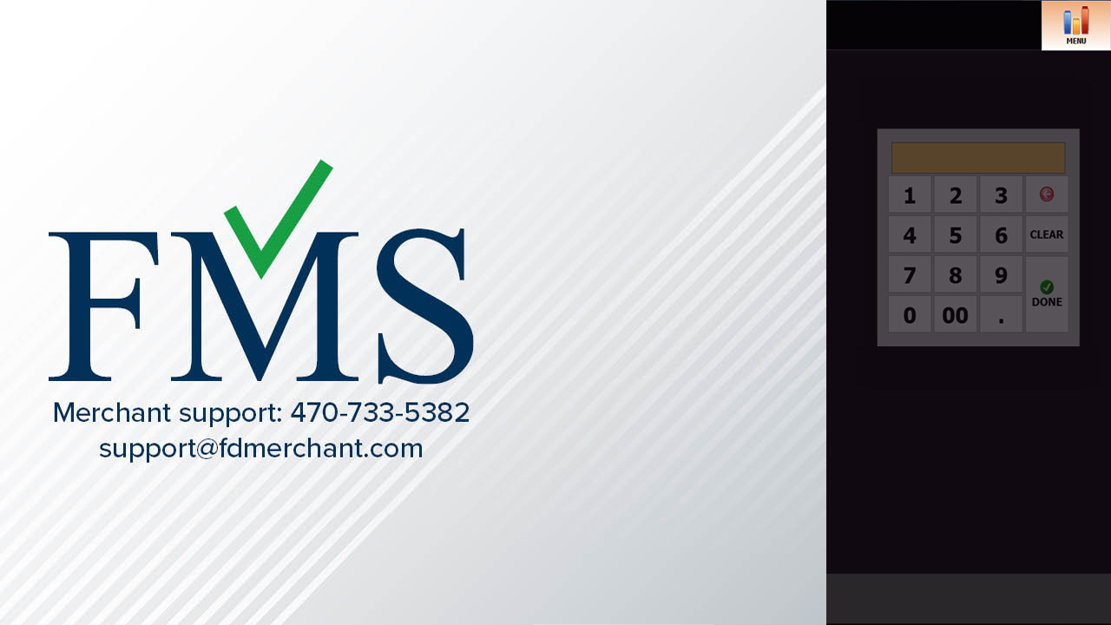
1. “How to Register” Administrator
Press on “MENU”

Slide 5
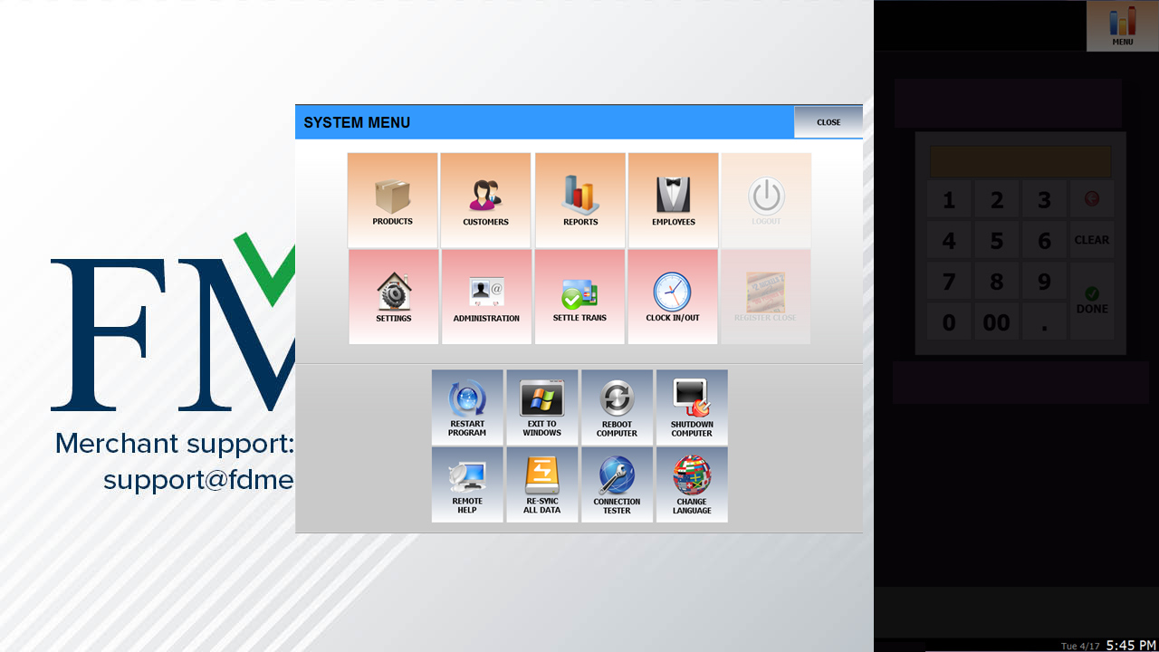
Press on “ADMINISTRATION”

Slide 6
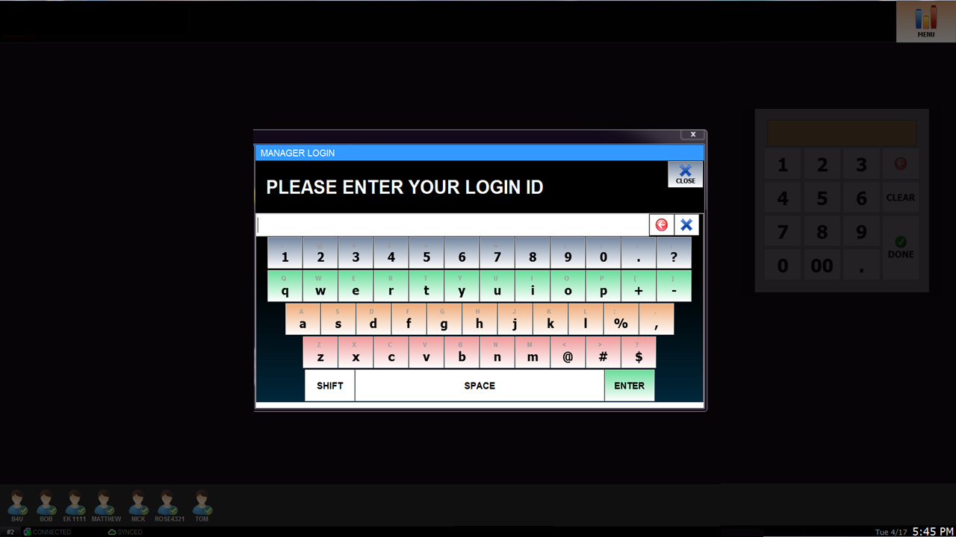
Press on “NAG” on “MANAGER” on top left corner.

Slide 7
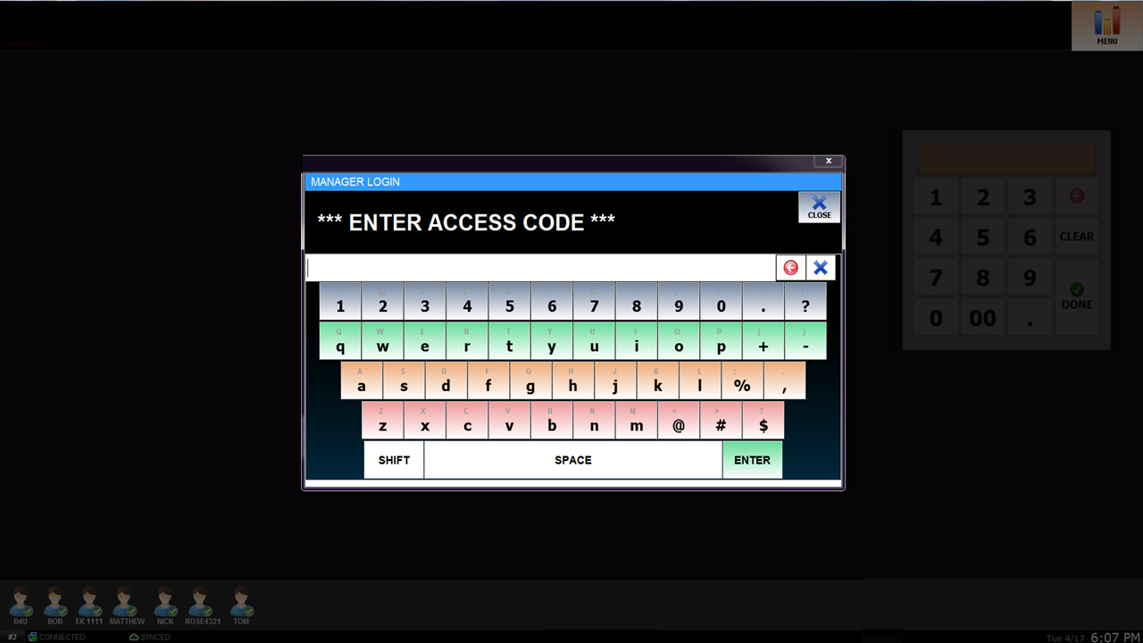
You’ll be asked to enter the “ACCESS CODE”
Please contact FMS to receive a Access Code.
470-733-5382

Slide 8
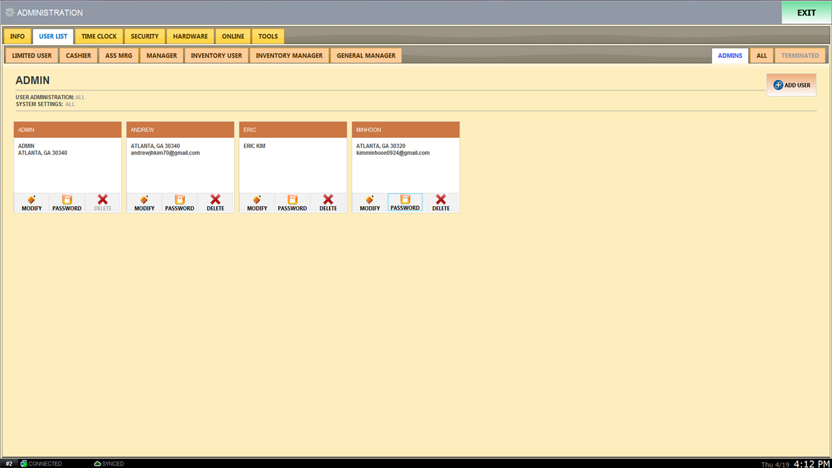
1
2
1. Press on ADMINS “1” to go on current page to see all Administrators.
Press on ADD USER “2” to add and set Administrators and Password.
Please turn to the next page.

Slide 9
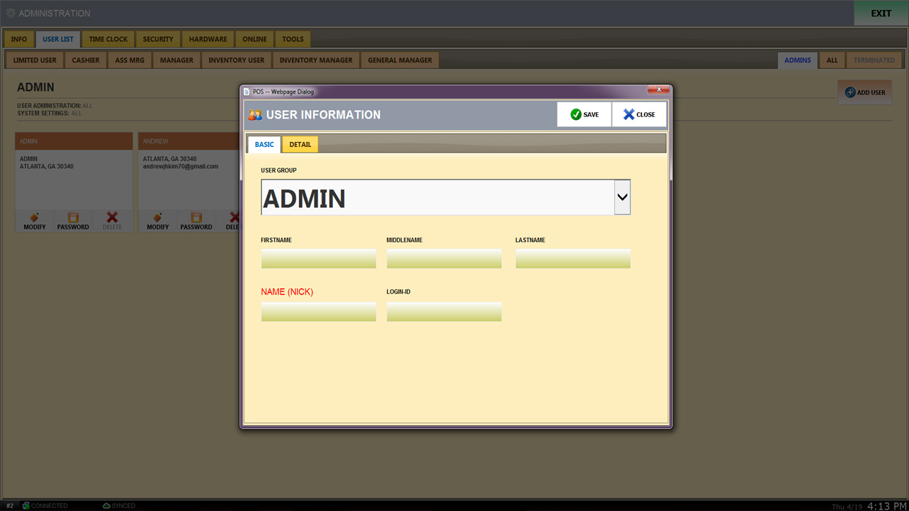
2
"Name”
“Administrator USER ID”
“ID must be at least 5 letters”
Please turn to the next page.

Slide 10
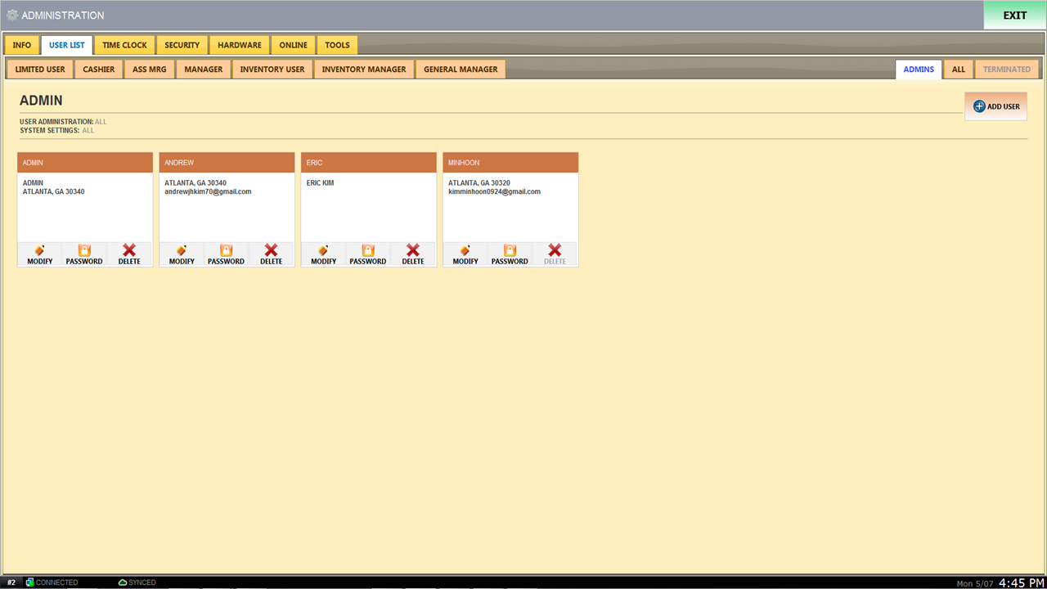
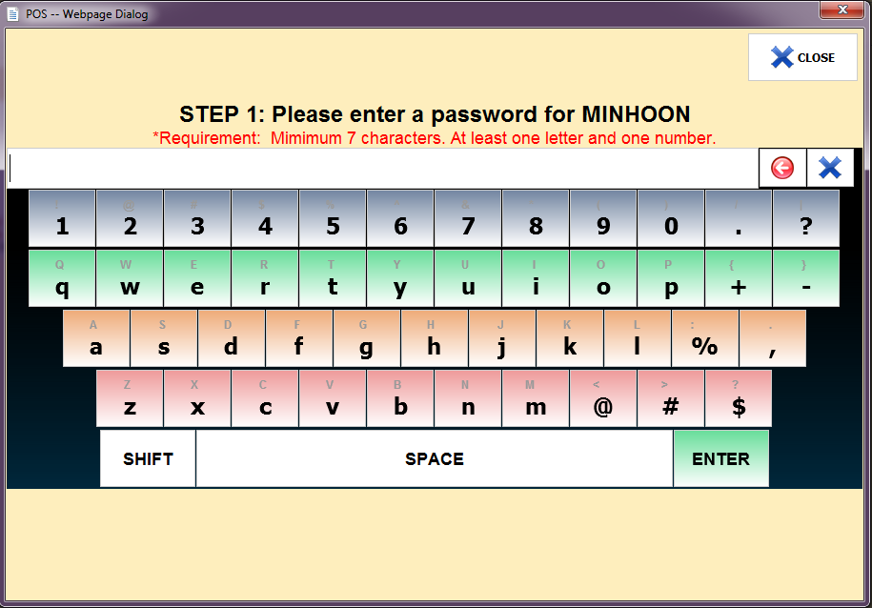
1
Press on PASSWORD “1” to display the following window and create your PASSWORD.
※CAUTION※
PASSWORD must be at least 7 characters, You must start with a letter and contain at least 1 number.
Please turn to the next page.
10

Slide 11
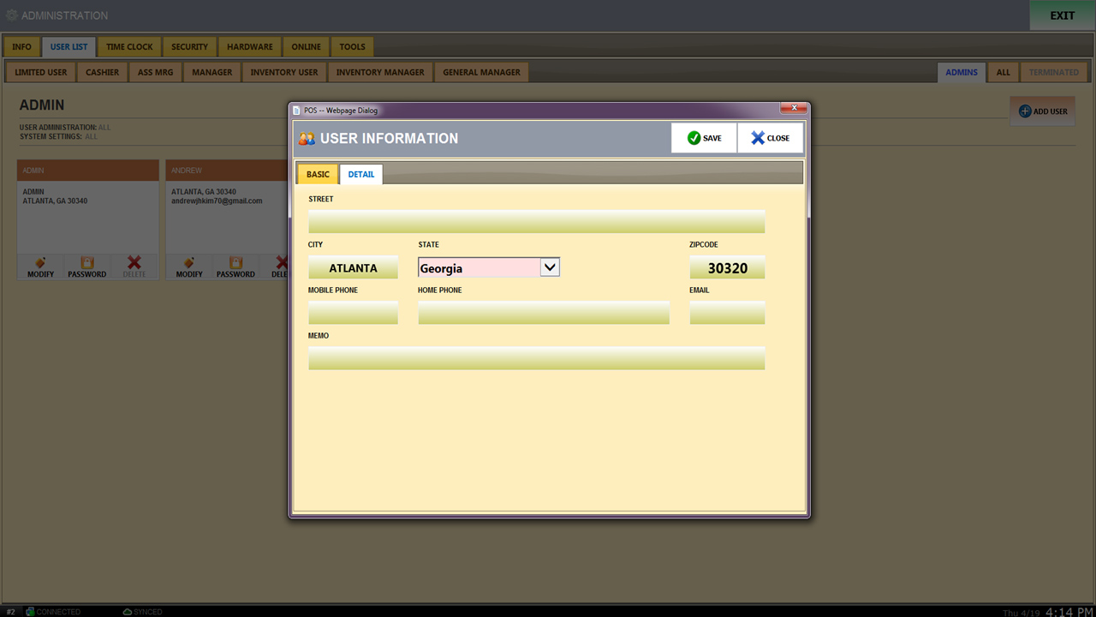
Enter your “EMAIL” address if you would like to receive reports, such as SALES REPORT, VOID, RETURN, and DISCOUNT. “Will be sent via e-mail.”

Slide 12
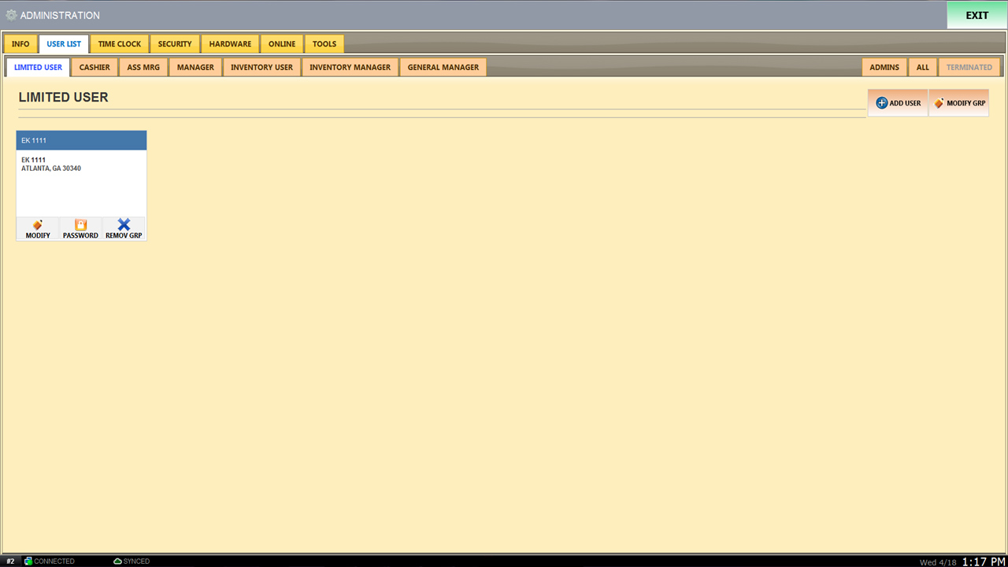
You may see ALL existing USERS on USER LIST tab.
To MODIFY GRP press on the USER you would like to modify. (Please move on to the next chapter.)
Press on “ADD USER” to create new USER and EMPLOYEE CODE.
Employees and USERS are/can be divided into seven different type of positions.
※CAUTION※
Please be aware of adding and changing names of a USER. *FOR EXAMPLE* If you click on “MANAGER” then you “MODIFY GRP” and change the name of “MANAGER” to “CASHIER” the USER created will still be listed as a “MANAGER”.

Slide 13
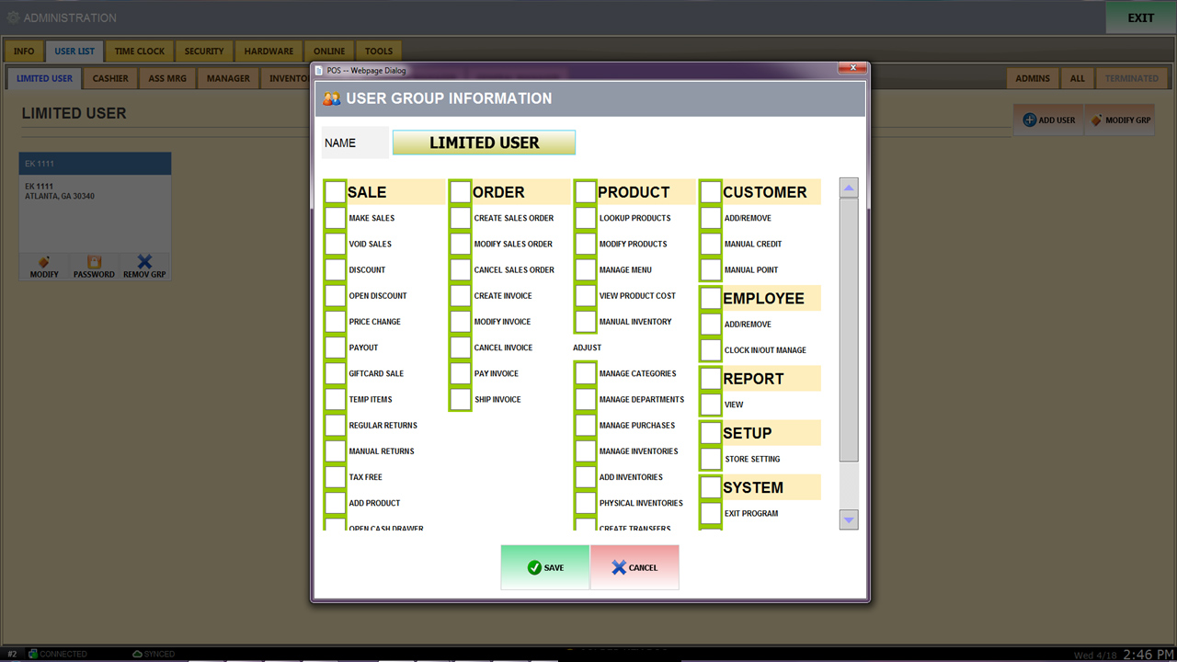
`
If you would like to change the name of a “LIMITED USER” all you have to do is double click “LIMITED USER” and type in the name.
Press on “MODIFY GRP” to grant access or to remove access on certain functions on any users on list.
These are the list of the functions that can be used by EMPLOYEES. SALE, ORDER, PRODUCT, CUSTOMER, EMPLOYEE, REPORT, SETUP, and SYSTEM. *If you press on “YELLOW” color check box, you will be able to use all functions in that current tab.

Slide 14
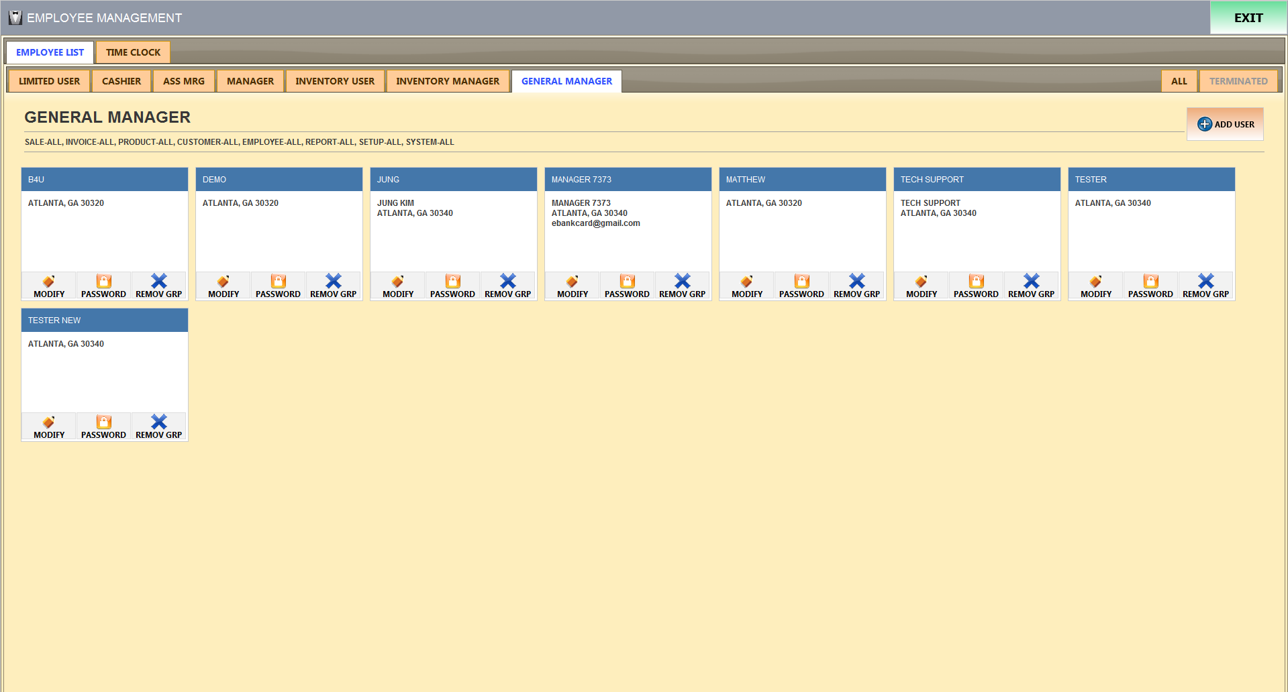
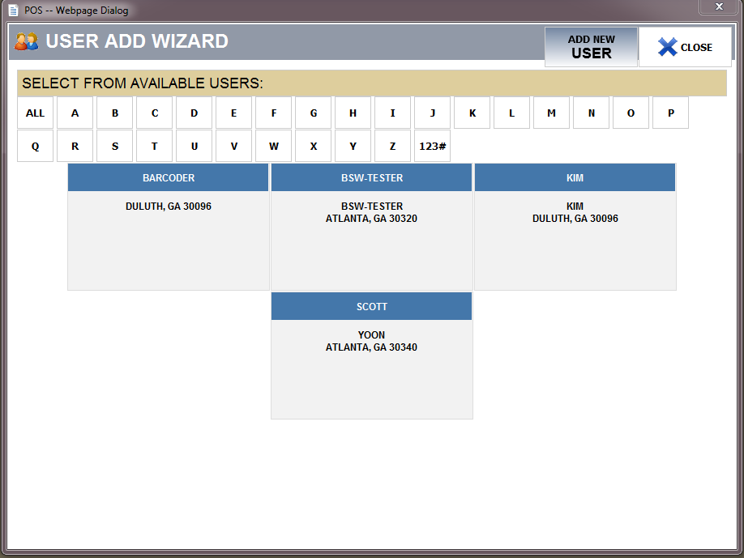
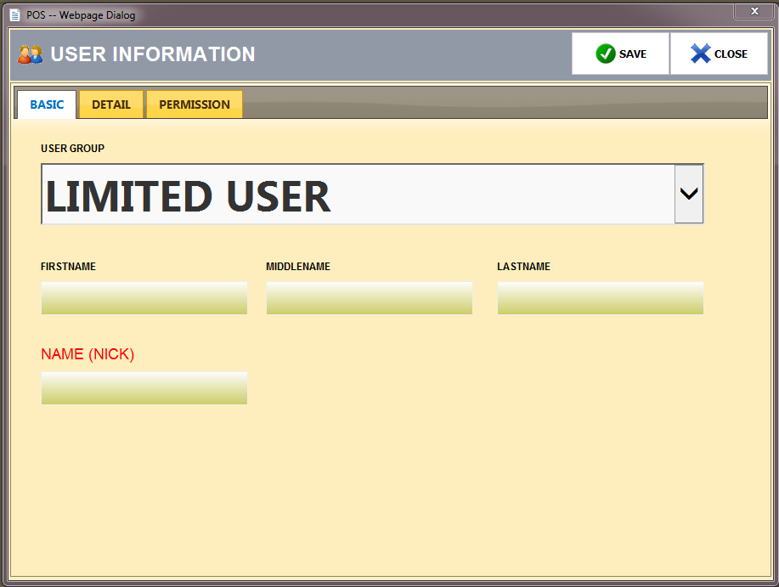
Choose a position that you are looking for.
Press ADD USER “1” to add a new USER.
Press ADD USER “2” as well.
※CAUTION※
※PLEASE READ※
PAGE 12.
1
2
3
Enter the name and press “SAVE”.
Please turn to the next page.
14

Slide 15
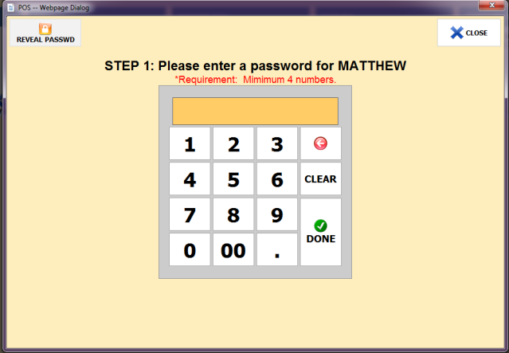
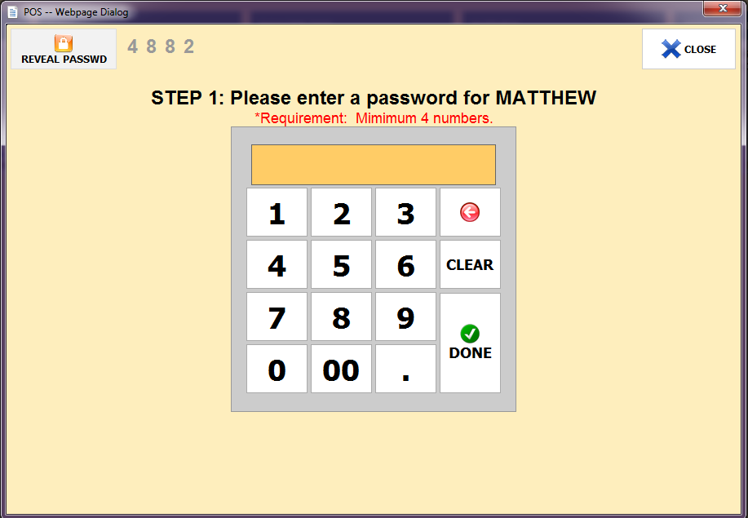
1
1. Press on PASSWORD “1”
2. Must enter your “PASSWORD” twice to confirm.
3. PASSWORD must be at least 4 digits long.
Once the “PASSWORD” process is finished, make sure to double check and confirm your “PASSWORD”. You may also reveal your “PASSWORD”.
Press → “PASSWORD” → “REVEAL PASSWD” [ON TOP LEFT CORNER]
15

Slide 16
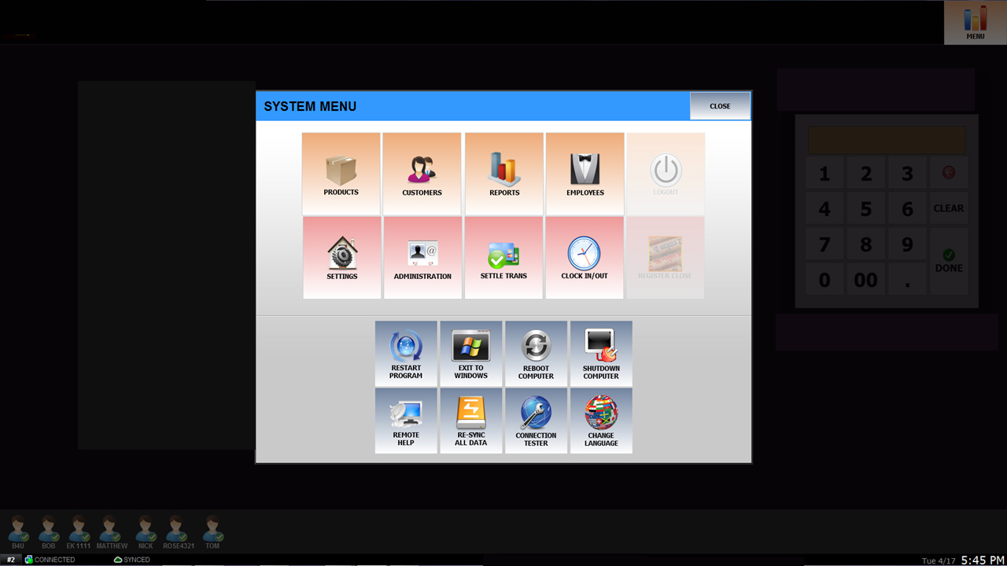
Press on “SETTINGS”

Slide 17
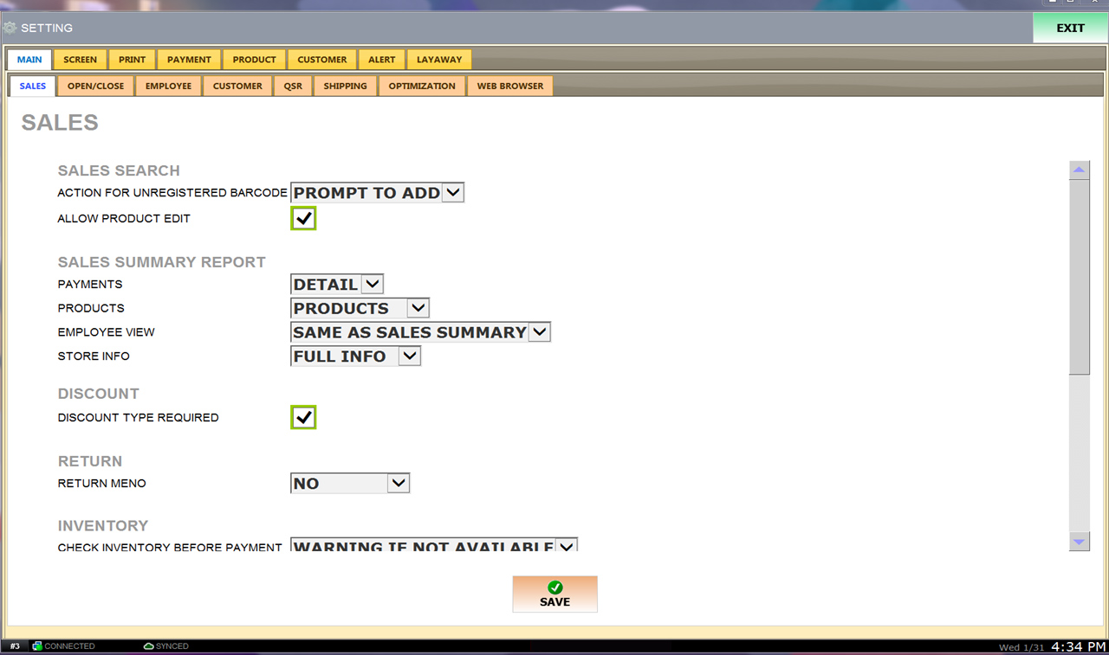
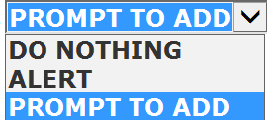

③
①
Check this button to allow Product Editing. Related to “#1”. You will not be able to edit any products if this is unchecked on sales screen.
1~4 System Guide.
Check this button to receive pop-up notification to take action when an barcode of an item is scanned and is unregistered.
②
DO NOTHING – Registered product does not appear on the sales screen.
ALERT – Warning of an unpublished product/barcode.
PROMPT TO ADD – Pop-up notification for scanned product.
④
DETAIL – “FULL INFO” of SALES SUMMARY REPORT.
SIMPLE – Cash & Card SALES DETAIL only.
Please turn to the next page.

Slide 18
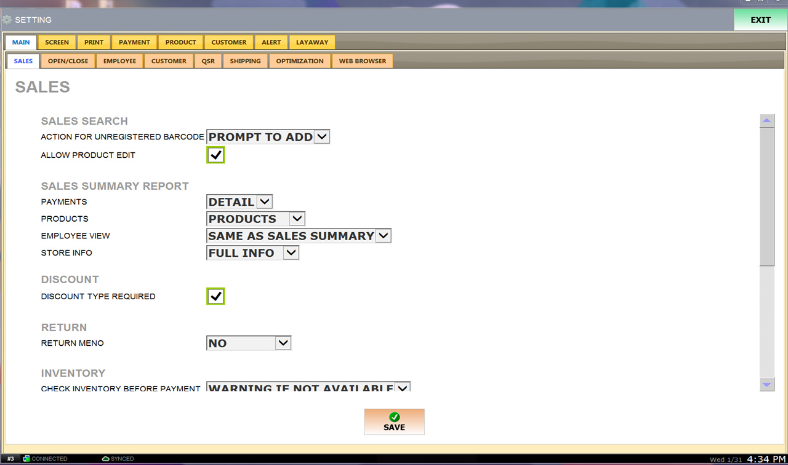
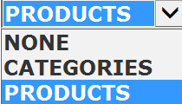

⑤
NONE – Sold products will not appear on report.
CATEGORIES – Quantity of specified category.
PRODUCTS – Detailed by products.
“SALES SUMMARY REPORT”
⑥
⑦
CASH ONLY – Details of CASH only at close.
SAME AS SALES SUMMARY – Details of Cash & Card transaction at close. ④, ⑤ Follow the guide #1~#7.
If all your sales was CASH ONLY. You can choose to get reports for CASH ONLY on BATCH REPORT.
NONE – No store information printed on report.
NAME – Store name ONLY printed on
report.
FULL INFO – Store name and phone
number will be printed on report.

Slide 19
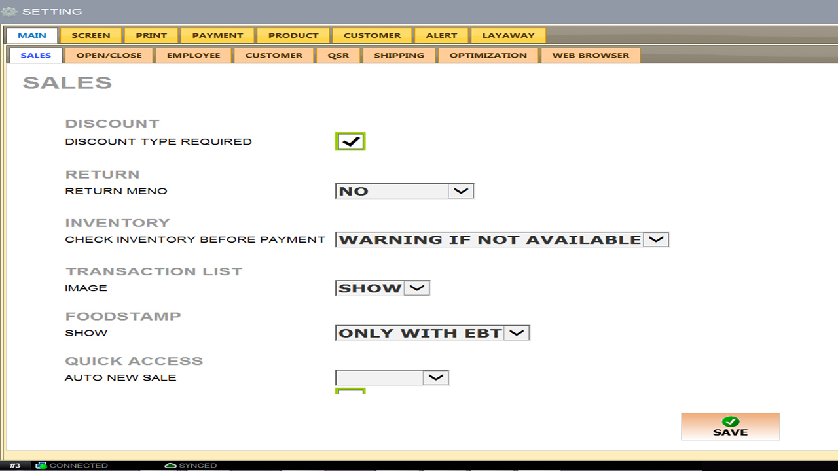

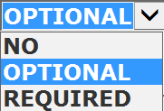
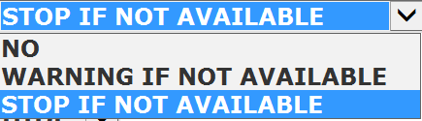
⑧
If checked, discount types will pop-up.
⑨
NO : No reason required for the return.
OPTIONAL : Reason for return notification.
REQUIRED : Reason required for return.
⑩
*COMING SOON*
NO : No information or reason for return.
WARNING IF NOT AVAILABLE : You may ignore the out of stock notification and sell the product.
STOP IF NOT AVAILABLE : Sales will not be available for products out of stock.
⑪
Government/Food Stamps EBT
⑫
After a transaction, automatically returns to sales screen.

Slide 20
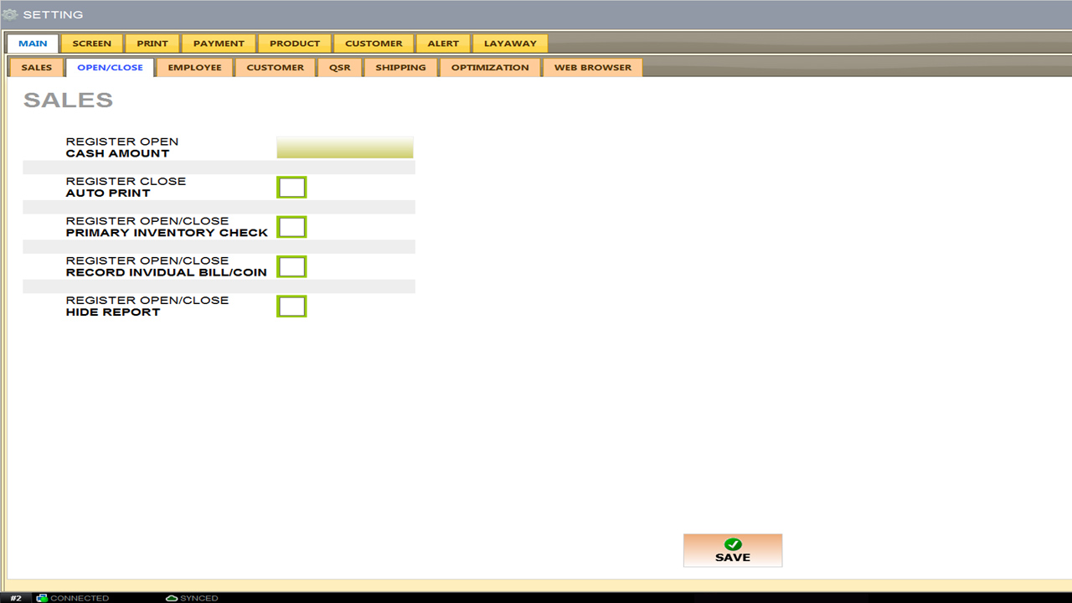
①
Setting starting amount money automatically.
②
Automatically prints closing report when closing register.
Open & Close Check Primary Inventory.
③
④
Bills & Coins records.
If checked, sales report will not show on the left side of the screen when Open & Closed.
⑤
Please turn to the next page.

Slide 21
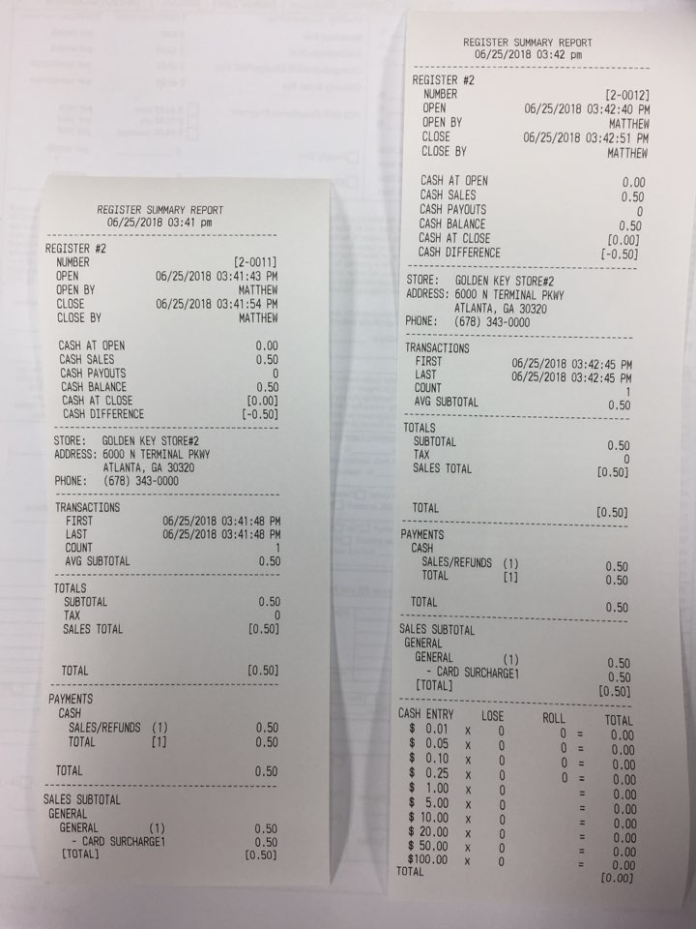
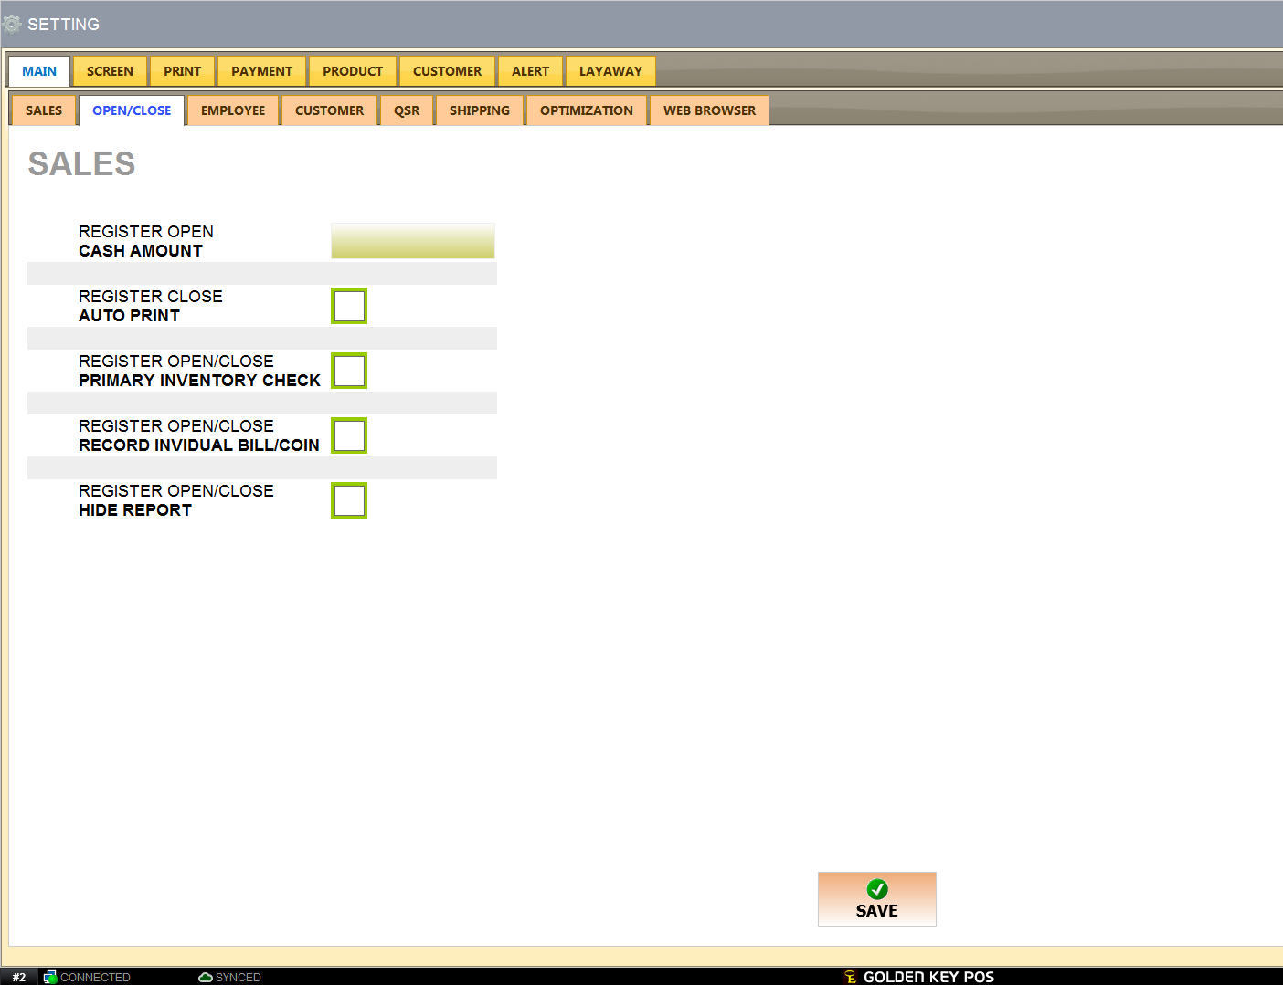
④
Transaction Record.
COINS show bottom of receipt.

Slide 22
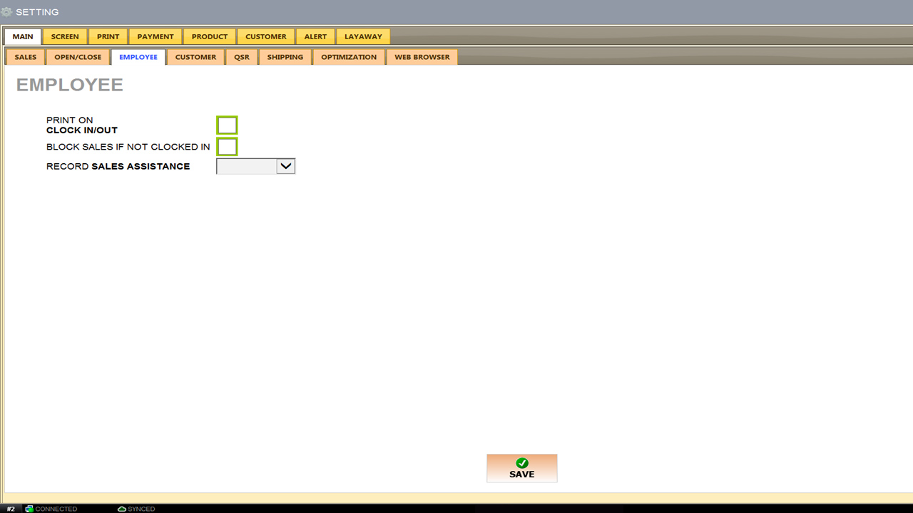
①
Print Clock-in & Clock-out Report
②
If checked, You will not be able to enter the sales screen if not Clocked-in.
③
Record names of salesperson.
Please turn to the next page.

Slide 23
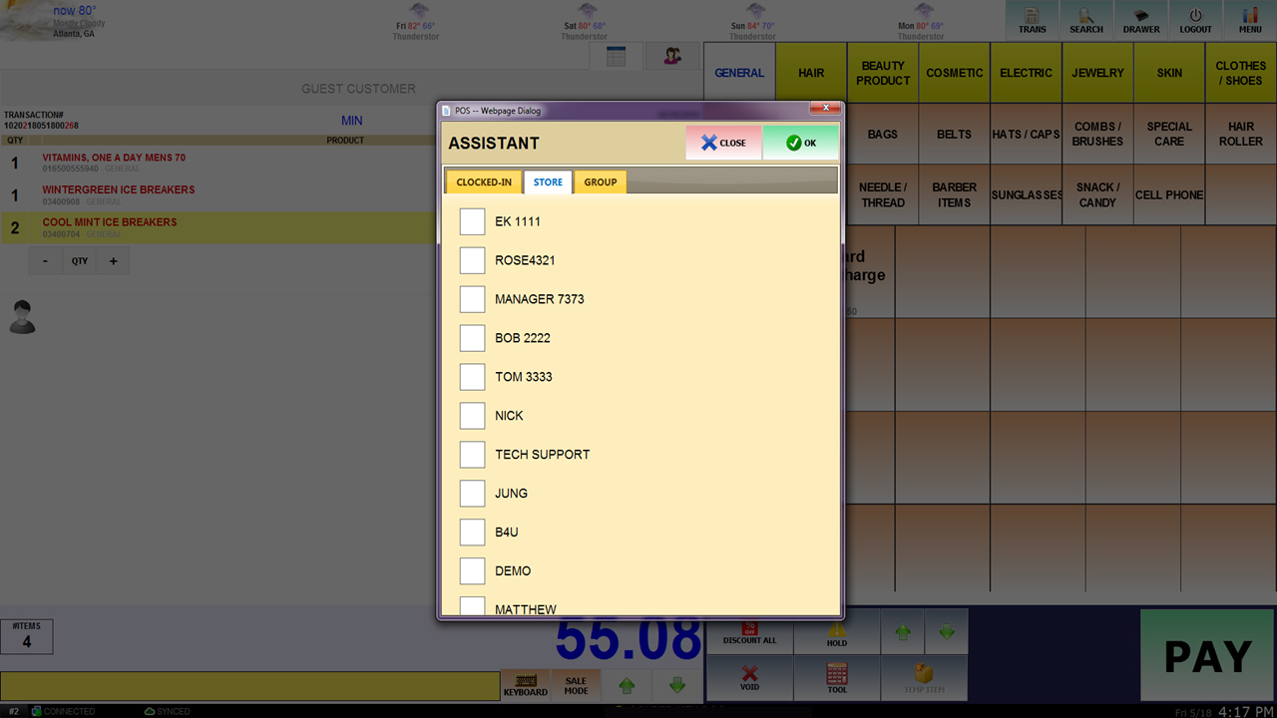
HOW TO APPLY RECORD SALES ASSISTANCE #2
2
1
3
Press on “1”
Press on “2”
Select a Sales Assistance. (Employee) “3”
Press on “4” to proceed with payment.
Please turn to the next page.
4

Slide 24
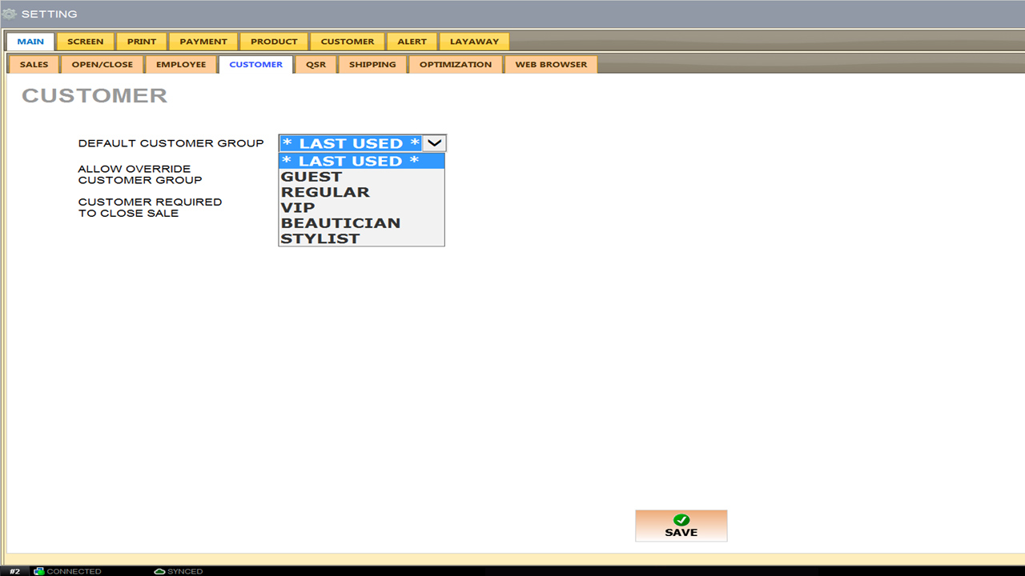
①
Default settings when registering customers. *LAST USED* Recommended.
②
Required customers information to make a sale.
Please turn to the next page.

Slide 25
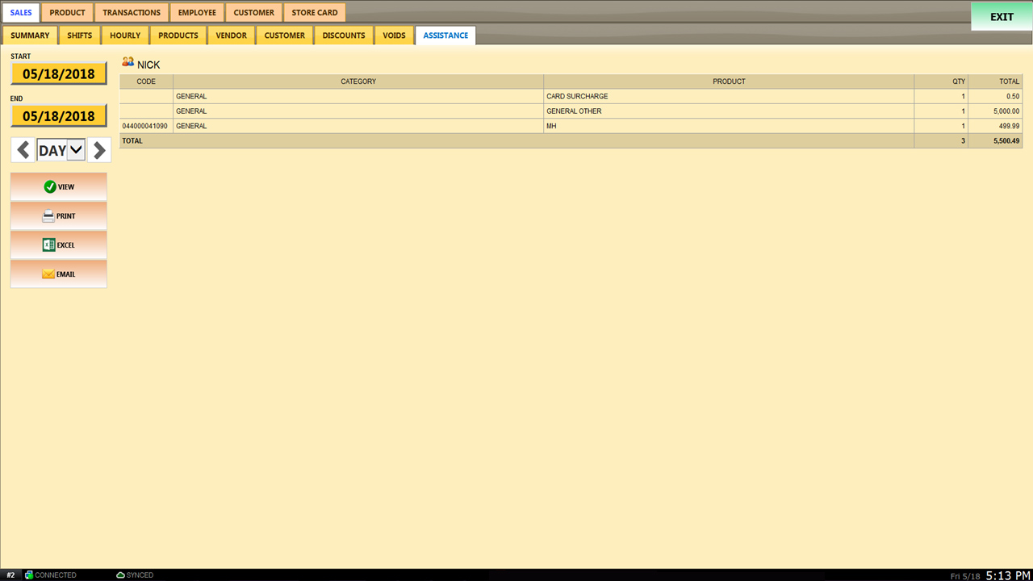
RECORD SALES ASSISTANCE 적용 확인 방법 2
※CAUTION※
REPORT → SALES → ASSISTANCE

Slide 26

Please contact us at Golden Key POS for more information and details.
888.992.1715

Slide 27
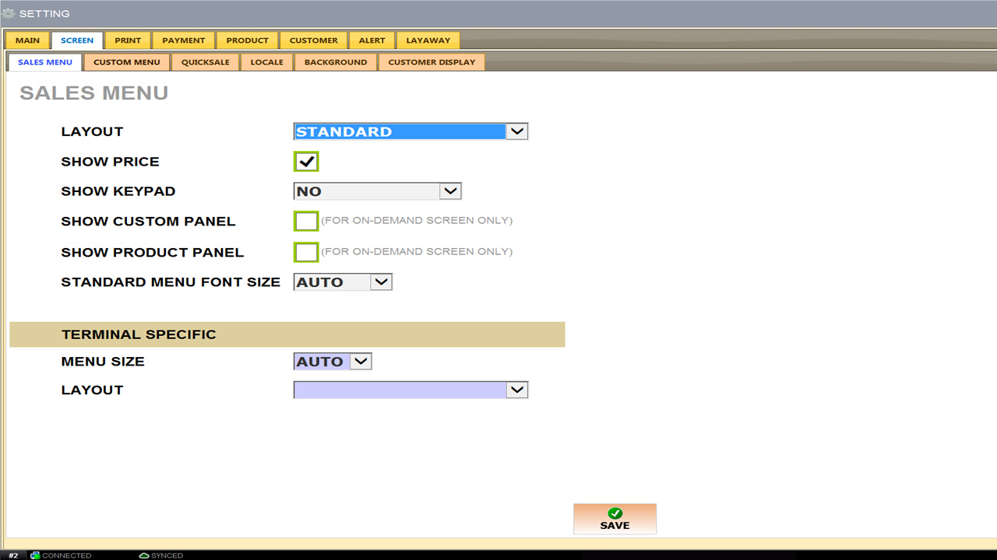
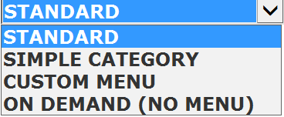
①
Categories only on sales screen.
②
Product price shown on customer/sales screen.
Customized/Edited products show on sales screen.
④
⑤
③
Keypad display next to sales categories.
Product button list not displayed on sales screen.
⑥
Menu Font Size should be selected as “AUTO”.
⑦
POS that is synced with TERMINAL SPECIFIC, when you log in you will see the sales screen that you have set it to.

Slide 28
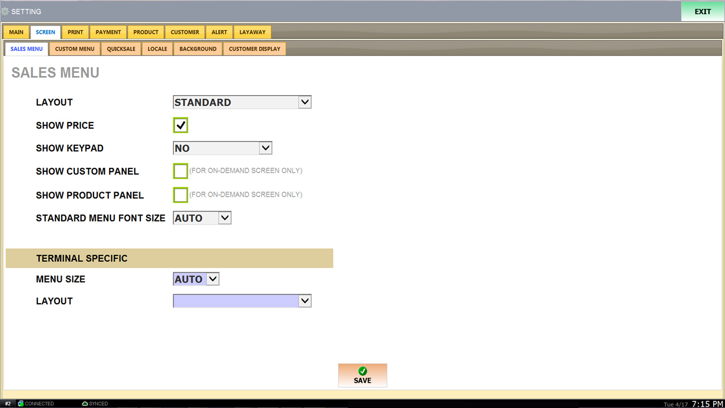
Please contact us at Golden Key POS for more information and details. Please check Golden Key POS Advanced Manual for more information and details.
888.992.1715

Slide 29
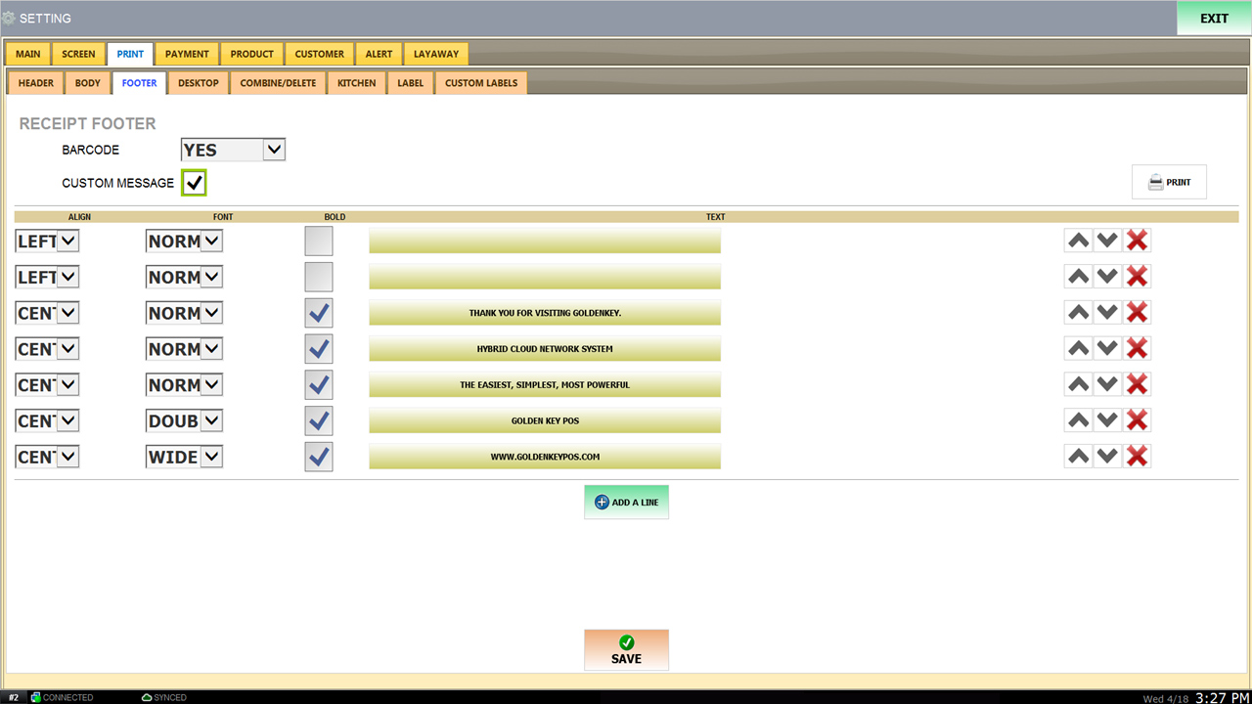
<- As shown on the screen.
Text shown on bottom of the receipt.
Press “ADD A LINE” to ADD A LINE.

Slide 30
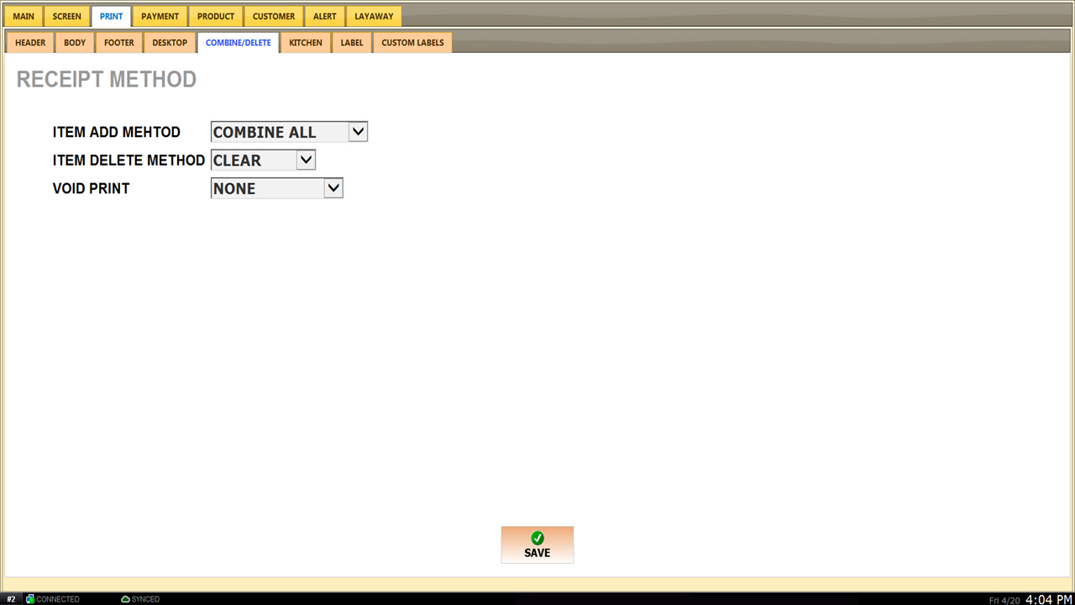
1
2
3
“1” “COMBINE ALL” Combines all scanned items and not individually on display.
“2” If set as “CLEAR” If you ring up the wrong item, press on the X button located under the item.
“2” If set as “DELETE” If you ring up a item and erase the item from the sales screen, you may be able to restore the item you have erased.
3. “3” If set as “NONE” you will not automatically receive VOID list on the sales report.

Slide 31
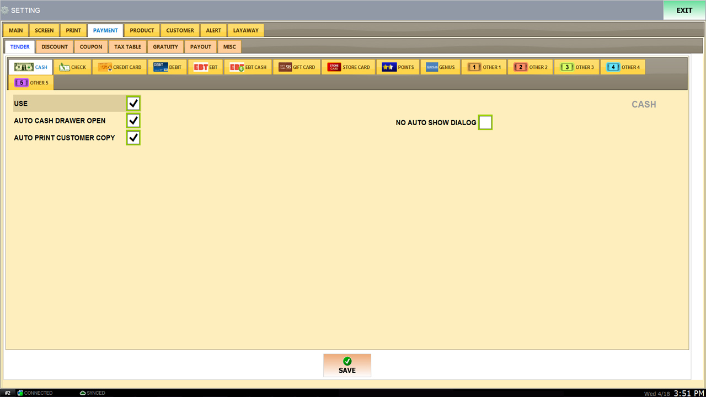
Set-up as display “CASH”.

Slide 32
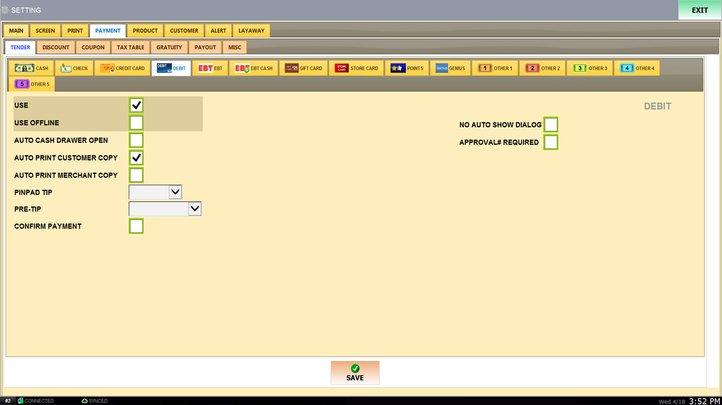
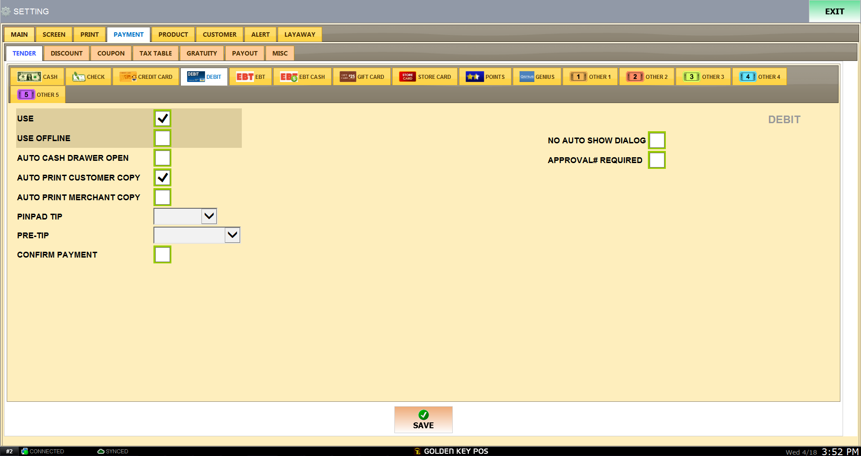
Cash drawer opens automatically after transaction.
Customer receipt copy automatically prints after transaction.
Set-up as display “GRATUITY”.

Slide 33
If you do not have a CARD MACHINE that is linked to the POS System and you would like to do it manually “OFFLINE” with an separate CARD MACHINE, make sure to check all boxes shown in the red box.
※CAUTION※
IF YOU ARE NOT USING A CARD MACHINE LINKED WITH THE POS YOU DO NOT NEED TO CHECK THE “USE” BUTTON.

Slide 34
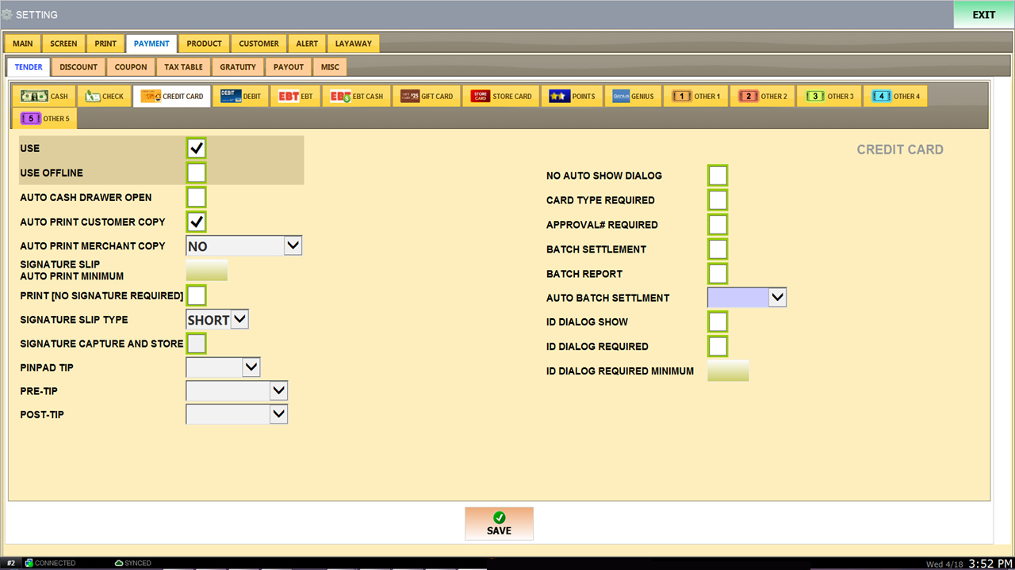
1 Copy of payment receipt.
Please turn to the next page.
Set-up as display.

Slide 35
“1" Transaction without confirming or entering number.
"2” Must check ID and enter ID Number to make a transaction.
ID Check for transactions over/required if the price exceeds required minimum amount.
1
2
3

Slide 36
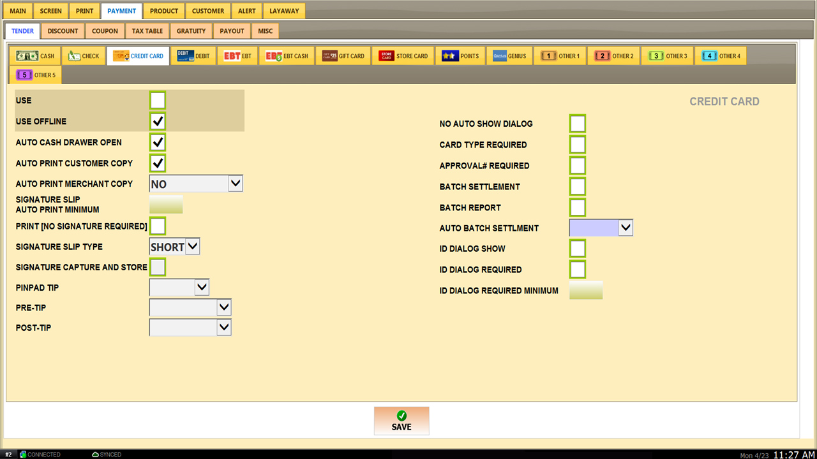
※CAUTION※
Do NOT check the “USE” button if you do not have a linked CARD MACHINE.
Set-up as shown above when Card Machine is not linked or connected.

Slide 37
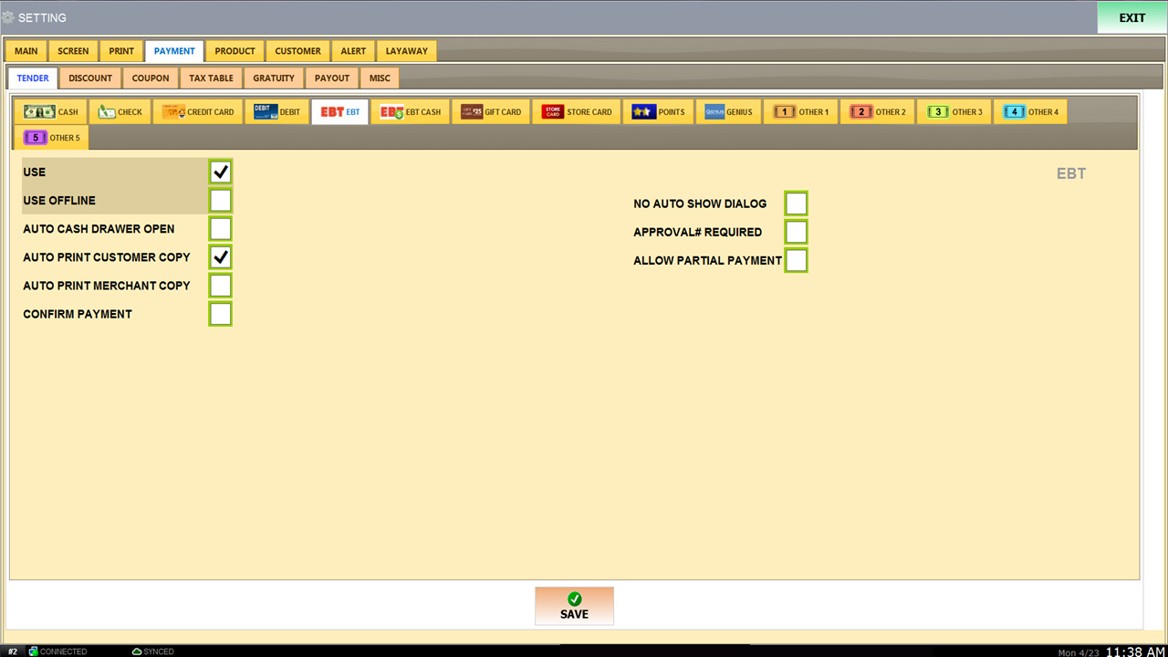
※CAUTION※
Do NOT check the “USE” button if you do not have a linked CARD MACHINE.
Set-up as display.

Slide 38
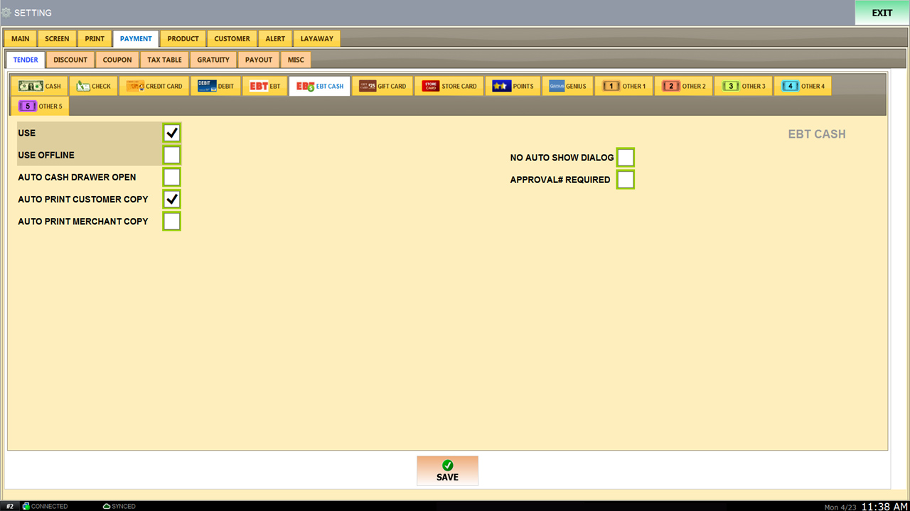
※CAUTION※
Do NOT check the “USE” button if you do not have a linked CARD MACHINE.
Set-up as display.

Slide 39
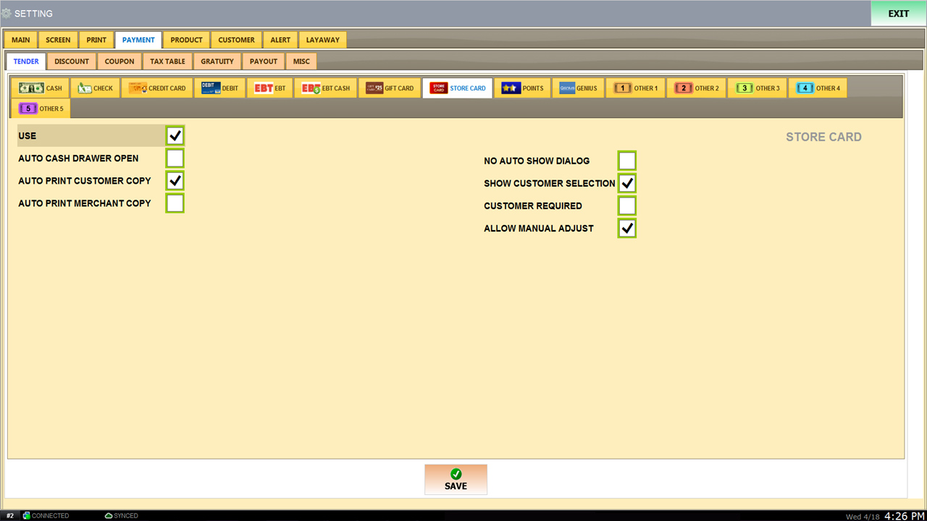
Set-up as display.

Slide 40
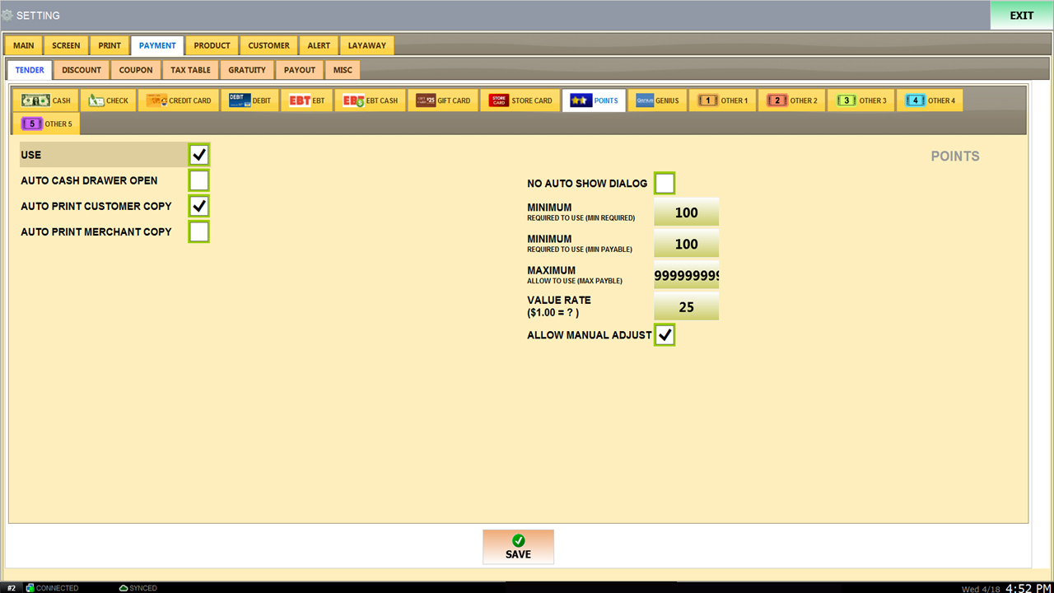
Please set the price equally.
Available from 100 = 100 POINT.
Follow the settings below.
1 ÷ 25 = 0.04 (4% CASH BACK )
Set-up as display.

Slide 41
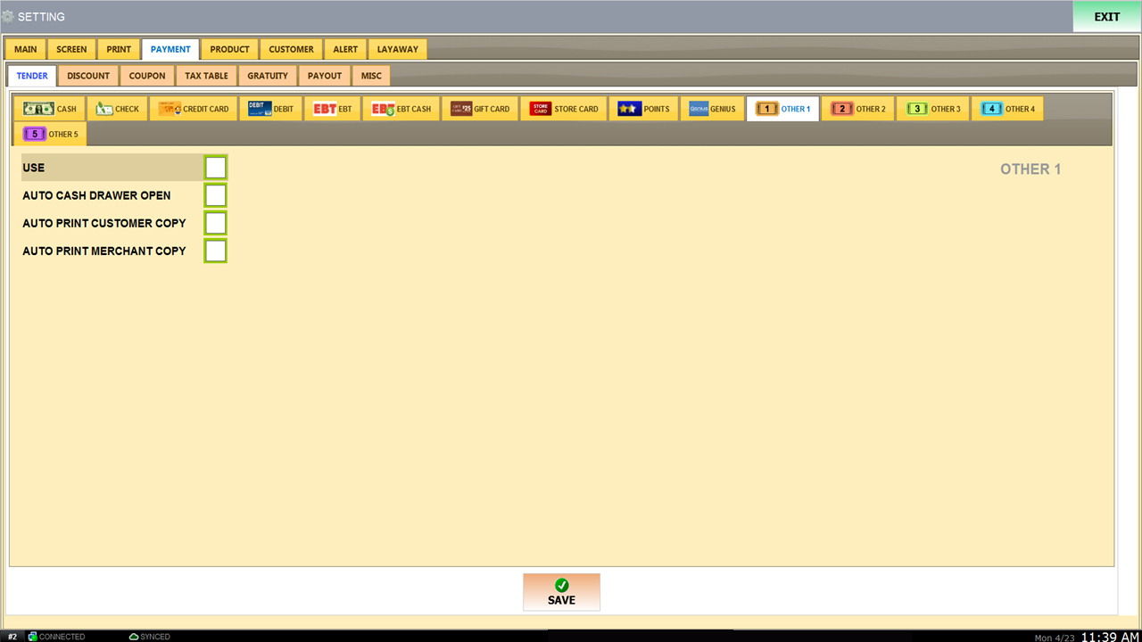
This feature is used for other payment methods.
Please contact us at FMS for more information.

Slide 42
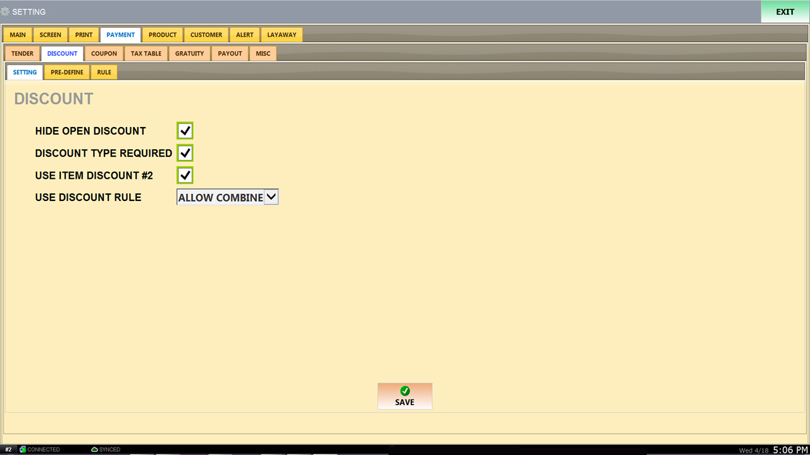
HIDE OPEN DISCOUNT.
Reason required for discount.
Duplicate discount.
How to set-up “DISCOUNT RULE”.
LOGIN SCREEN → MENU → PIRNT → COMBINE/DELETE → ITEM ADD MEHTOD
If set to “BLANK”, discount “RULE” is not applicable.
If set to “YES”, set “USE DISCOUNT RULE” should be set as “EACH SEPEREATED”.
If set to “ALLOW COMBINE” LOGIN SCREEN → MENU → PIRNT → COMBINE/DELETE → ITEM ADD MEHTOD →
COMBINE ALL, COMBINE LAST.

Slide 43
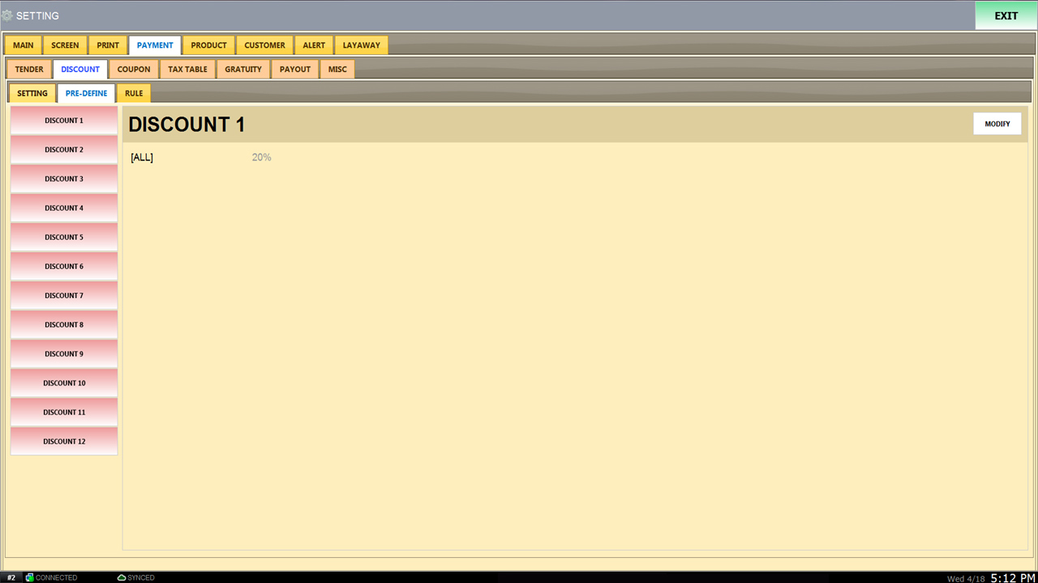
Apply discount type and name of the discount.

Slide 44
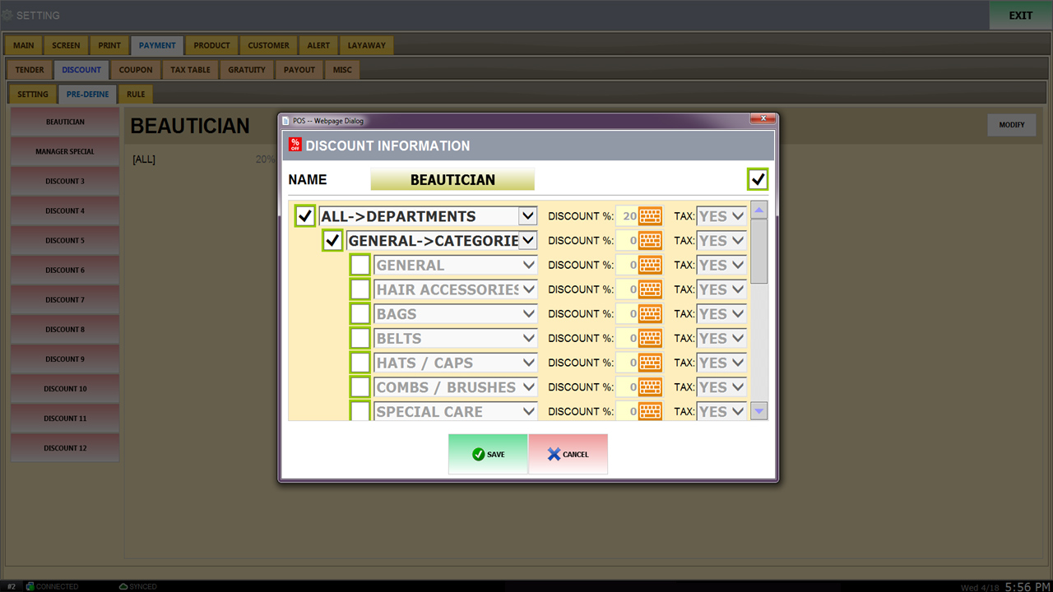
“NAME” Should be set as created discount type. Example “BEAUTICIAN”.
Set to
“ALL->DEPARTMENTS” to apply discount.
SET DISCOUNT %
TAX SET AS YES OR NO SETTINGS.

Slide 45
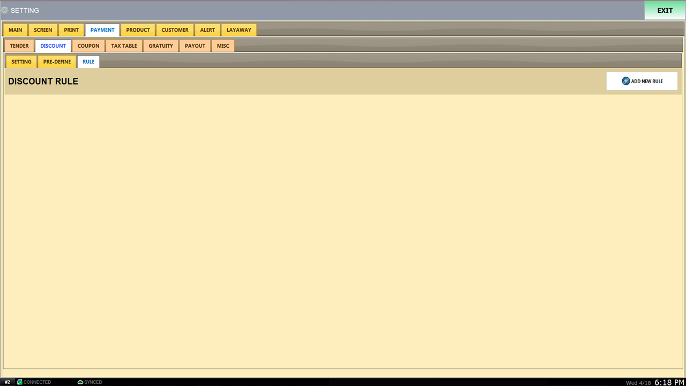
ADVANCED FMS Manual.

Slide 46

Enter your local state/city TAX. Press save when done.
Press “RESTART PROGRAM” next to “EXIT at the top right.

Slide 47

ADVANCED FMS Manual.

Slide 48

Set-up as display.

Slide 49

Set-up as display.

Slide 50

ADVANCED FMS Manual.

Slide 51

CUSTOMER LIST on SALES SCREEN. (ADD OR SEARCH)
REQUIRED CUSTOMER INFORMATION

Slide 52

Set a group of customers and select one of Pre-Defined Discount for Default Discount, the discount is automatically applied according to the group of customers.

Slide 53

$1 = 1 point.
Set as 0.
COUPON REQUIREMENT = 100 points.

Slide 54

ALWAYS : Points with discount products.
EXCLUDE : No points with discount products.
ALWAYS : Receive points when you make a purchase with points.
EXCLUDE ENTIRE SALE : No points received with point transaction.
SUBTRACT POINT AMOUNT: Subtract the amount of points.

Slide 55


Automatic notification by e-mail when problems occur during sales.
If there is any problems, please contact us at Golden Key POS.
Notified when OPENING/CLOSING.
Notified when VOID.
Notified when RETURNS.
Set a minimum amount to be notified.
Notified when PURCHASE/RELOAD on gift cards.
Notified when STORE CARD is in use.
Notified when manually adjusting.
Notified when taking money out of the cash drawer.
Notified when CASH DRAWER is opened when no sale has occurred.

Slide 56

When PRODUCT INFORMATION CHANGES, you will receive a
e-mail.

Slide 57

ADVANCED FMS Manual.

Slide 58
Login Screen
SALES GUIDE.
57

Slide 59

2
1
REGISTER OPEN
“1” Calculate money in CASH DRAWER.
“1” 100 cents = $0.01 x 100.
“2” Total money in CASH DRAWER.
Press Save.

Slide 60

2
1
3
REGISTER CLOSE
“1” Calculate money in CASH DRAWER.
“1” 100 cents = $0.01 x 100.
“2” Total money in CASH DRAWER.
“3” “Difference” Missing or Over money.
When finished closing, Press Save.

Slide 61






Sales Menu Fucntion
SINGLE PRODUCT VOID
MEMO : Notes, Information, Details.
TAX FREE : Selected item will only be taxed.
Modify price for product.
Select a predefined discount.
“HOLD” will save the list of products that has been inputed.
VOID ALL.
Total discount.
Discount Type Menu.

Slide 62


Sales Screen.
①
②
③
④
⑤
⑥
⑦
⑧
⑨
⑩
⑪
⑫
⑬
⑭
⑮
16
17
18
19
20
21
22
23
24
25
26
27
28
Please turn to the next page.

Slide 63

TOOLS 버튼 용도
1. ADD : Ability to enter the product manually.
2. SEARCH : Search for any products. (Can be searched in various ways)
3. SERIAL NUMBER : Find product by searching the Serial Number. (S/N.)
4. BREAK CASE : Used to match inventory, (Individually)
5. RETURN : After clicking the “RETURN” button, scan the customer’s barcode that is on the receipt. Then click the products that are to be returned then once again press the “RETURN” button.
6. PRINT : Print the current sale screen.
7. TAX FREE : All products “TAX FREE” buttons.
8. BULK : Write down and create all inventory details and information on EXCEL.
9. HISTORY : You can see the TRANSACTIONS of the desired date.
10. OPEN LIST : You can see unpaid open tickets.
11. HOLD PERMANENTLY : You can hold a open ticket permanently. It can be recalled from the OPEN LIST.
12. FOOD BALANCE : “Checking”.
13. PURCHASE : A function to load money in GIFT CARD.
14. RELOAD : You can reload GIFT CARD.
15. CHECK BALANCE : You can check the balance on the GIFT CARD.
16. STORE BALANCE : STORE BALANCE
17. POINT : Customers can earn points by purchasing products.
18. LIST : Search for specific customers.
19. PAYOUT : You can withdraw cash and do pay out.
20. RELOAD MENU : When modifying sales menu. (Press RELOAD menu).
21. CALCULATOR : Built-in CALCULATOR.
22. CALENDAR : Built-in CALENDAR.
23. OPEN DRAWER : You can open the CASH DRAWER.
24. RUNNING TOTALS : You can view REPORT from OPENING REGISTER.

Slide 64

Payment Method
To pay, press the PAY button.

Slide 65

Payment Method.
1
Select a payment method.
“1” Payment method for CREDIT CARD OFFLINE is used when credit card machine is not linked.
손님이 내신 금액 그대로 입력. 여기에서 금액을 맞춰주면 됨.
잔돈 없이 지폐로 낼 가능성 을 추측해 계산.

Slide 66

HOW TO ISSUE STORE CARD #1
Before giving STORE CREDIT.
“1” Change to “RETURN” mode.
“2” Click “PAY”.
Please turn to the next page.
2
1

Slide 67

HOW TO ISSUE STORE CARD #2
1
Click #1 STORE CREDIT.
Please turn to the next page.

Slide 68


HOW TO ISSUE STORE CARD #3
1
Before giving STORE CREDIT
Confirm the amount “1”
CUSTOMER ACCOUNT press “2”
GUEST ACCOUNT press “3”
2
3

Slide 69

PRODUCT REGISTATION METHOD
①
②
③
①
Press on DEPARTMENT “Yellow”
②
Press on CATEGORY “Green”
Products without barcodes can be sold pressing ③
Please turn to the next page.

Slide 70




Product registration during sales.
①
②
Screen appears when you scan product for the first time.
Select DEPARTMENT, then select CATEGORY.
③
④
When the DESCRIPTION appears, match the product name and press SELECT. Can be modified by pressing EDIT.
After entering PRICE, press DONE.

Slide 71


Slide 72




Product Registration Method
(MENU → PRODUCT)
①
②
MENU → PRODUCT
Scan the product.
③
④
EDIT : Edit product and name.
DEPARTMENT → CATEGORY.

Slide 73

How to modify and register products.
Add product to DEPARTMENT.
Change product name.
Product barcode number. If you touch or delete the barcode, you have to register the product again.
Product purchased price.
Change product price.

Slide 74

RETURN GUIDE.
How to RETURN with RECEIPT BARCODE.
(MANUAL RETURN MODE) How to switch from SALES mode to RETURN mode.
How to find and return payment.

Slide 75


HOW TO RETURN WITH RECEIPT BARCODE.
Scan the barcode below the RECEIPT. (A pop-up window will show on screen. Scanning is not possible if the barcode is damaged.
Press on the RETURN button at the top.
WOULD LIKE TO RETURN? PRESS OK.
Please turn to the next page.
*RECEIPT BARCODE*

Slide 76

HOW TO RETURN WITH RECEIPT BARCODE.
After confirming the quantity of the product, if you would like to return 1 out of the 3 products then press on the number once. If you like to return all 3, go ahead and press it 3 times.
Press on RETURNING product.
Please turn to the next page.

Slide 77

HOW TO RETURN WITH RECEIPT BARCODE.
After selecting RETURN product, press the RETURN button at the bottom right
Please turn to the next page.

Slide 78

HOW TO RETURN WITH RECEIPT BARCODE.
® stands for RETURN mode.
2. If the product price is showing by minus (-), press the PAY button.
Please turn to the next page.

Slide 79

1. Check if TOTAL PRICE is ( - ).
2. Select “PAYMENT METHOD”.

Slide 80

2. (MANUAL RETURN MODE) SALE 모드에서 RETURN 모드로 변경 방법.
1. Change from SALES MODE to TURN MODE on the bottom. (Red Box)
2. SALES MODE = Yellow | RETURN MODE = Red
Please turn to the next page.

Slide 81

2. (MANUAL RETURN MODE) How to change from SALES MODE to RETURN MODE.
Press RETURN.
Please turn to the next page.

Slide 82

2. (MANUAL RETURN MODE) How to change from SALES MODE to RETURN MODE.
Change from SALES MODE to RETURN MODE. (Red Box)
2. SALES MODE = Yellow | RETURN MODE = Red
Pay method is the same as general payment method.
Please turn to the next page.

Slide 83
2. (MANUAL RETURN MODE) How to change from SALES MODE to RETURN MODE.
Press on SALE.
※CAUTION※
You must change back to SALES MODE before making any sales after being on RETURN MODE.

Slide 84

3. How to find payment details in TRANSACTION and RETURN.
1. Press on TRANS.
Please turn to the next page.

Slide 85

5
4
2
1
Press on the TRANSACTION you would like to return.
Press RETURN.
WOULD LIKE TO RETURN? Press OK.
Change and see transaction from another date. “4”
If you cannot find the TRANSACTION you are looking for, press on “ALL TERMINALS” “5”.

Slide 86

Click on RETURNING product.
Please turn to the next page.

Slide 87

After selecting a RETURN product, Press the RETURN button at the bottom right.
Please turn to the next page.

Slide 88

Return payment method same as normal payment method.

Slide 89

카드 마감,배치 방법
Press on
“SETTLE TRANS”

Slide 90

Press OK.

Slide 91

Enter code.

Slide 92

SHOWN HERE IS A “TRANSACTION SETTLEMENT"
CREDIT AMOUNT,
CREDIT COUNT appears on the same screen. If this window is shown on display, card closing is competed.

Slide 93

ERROR when POS is “CLOSED”
And no ticket or transaction is found.

